Slide 1
Segmentation algorithm for Infrared Images
Jaisil Rose Dennison

Slide 2
OUTLINE:
Motivation
Flowchart
Image thresholding and labeling
Length based filtering and Morphological processing
Height_weight ratio filtering
Morphological refining
Segmented Output
Results and conclusion
References

Slide 3
Motivation:
One image is worth thousand words. Computer vision is the area where the computer are taught how to see!
Segmentation is a crucial step in it! According to wikipedia, segmentation is the processing of partitioning images into multiple segments.
An effective segmentation algorithm paves way for good classification or object localization.
In following slides, we will see segmentation algorithm based on morphological operations.

Slide 4
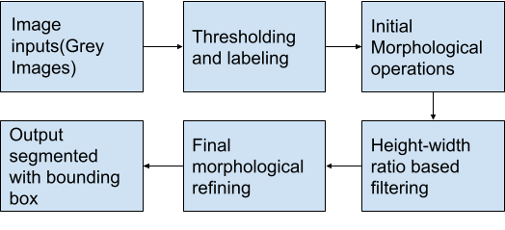
FLOW CHART:

Slide 5
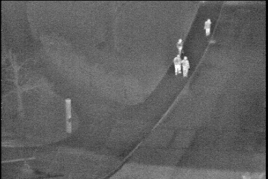
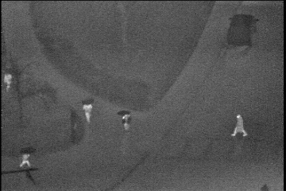
INPUT IMAGES : IR images in raining conditions
Training Image
Testing Image
( from OCTBVS infrared data set)

Slide 6
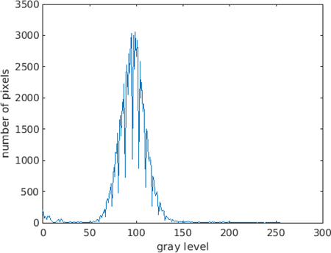
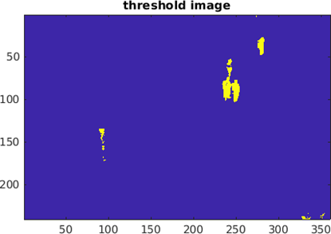
Thresholding(Training)
Histogram of training image
Thresholded Image (Threshold value: 156)

Slide 7
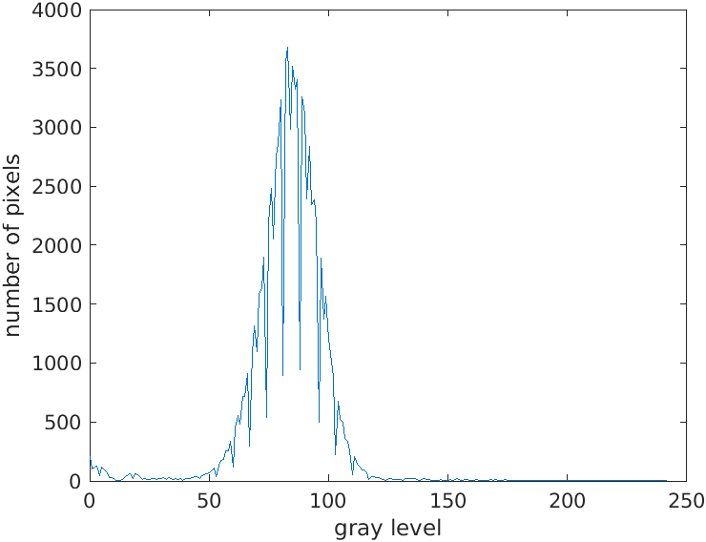
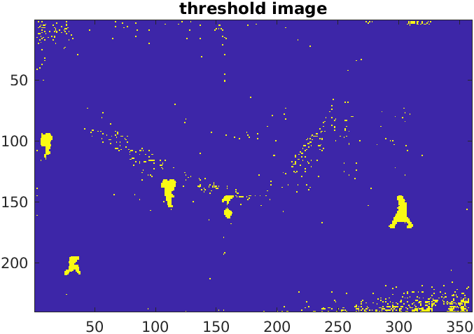
Thresholding(Testing)
Histogram of testing image
Thresholded Image (Threshold value: 110)

Slide 8
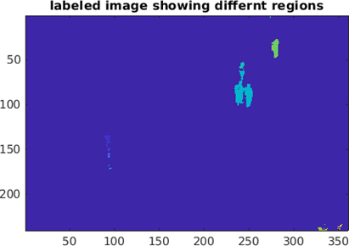
Labeling
Labeled image

Slide 9
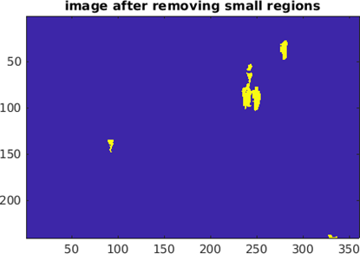
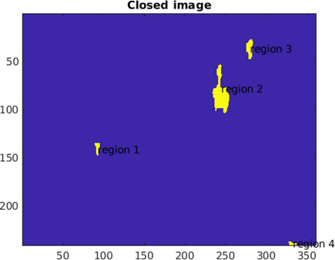
Length based filtering and morphological processing
Length based filtering( length range above 20)
Morphological closing (Square : 7 x 7)

Slide 10
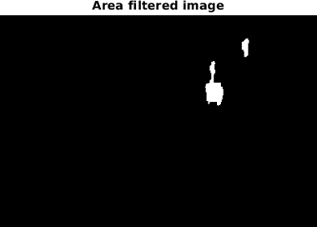
Height width ratio based filtering
Range of height width ratio: above 1.1

Slide 11
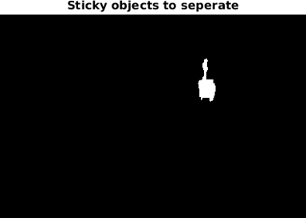
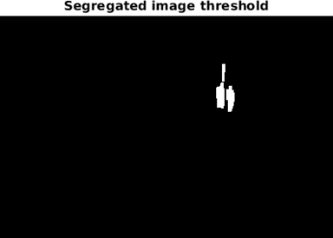
Morphological refining
Sticky objects:
Sticky objects separated:

Slide 12
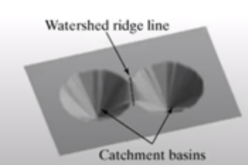
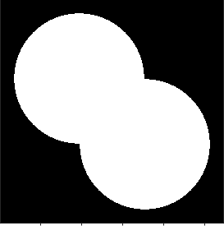
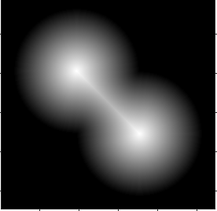
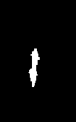
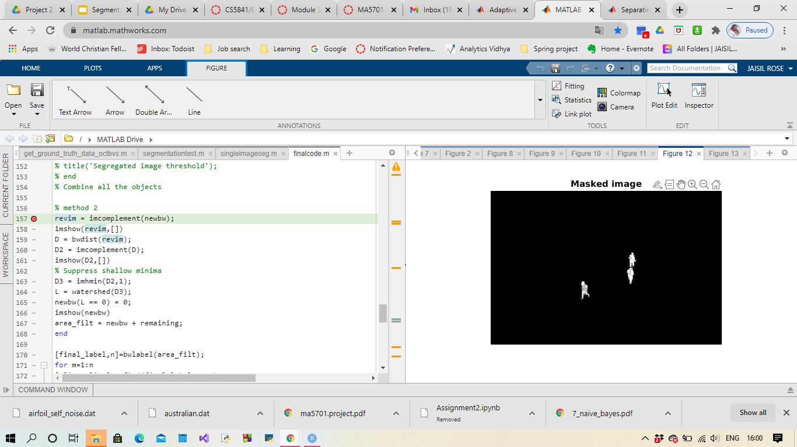
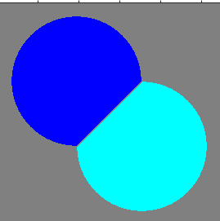
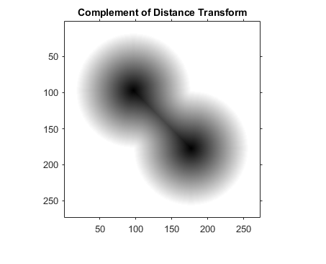
Segmented output : Trial watershed segmentation
Basic idea
Sticky objects
Distance transform
Sticky objects Separated
Finally separated!
Inverse

Slide 13
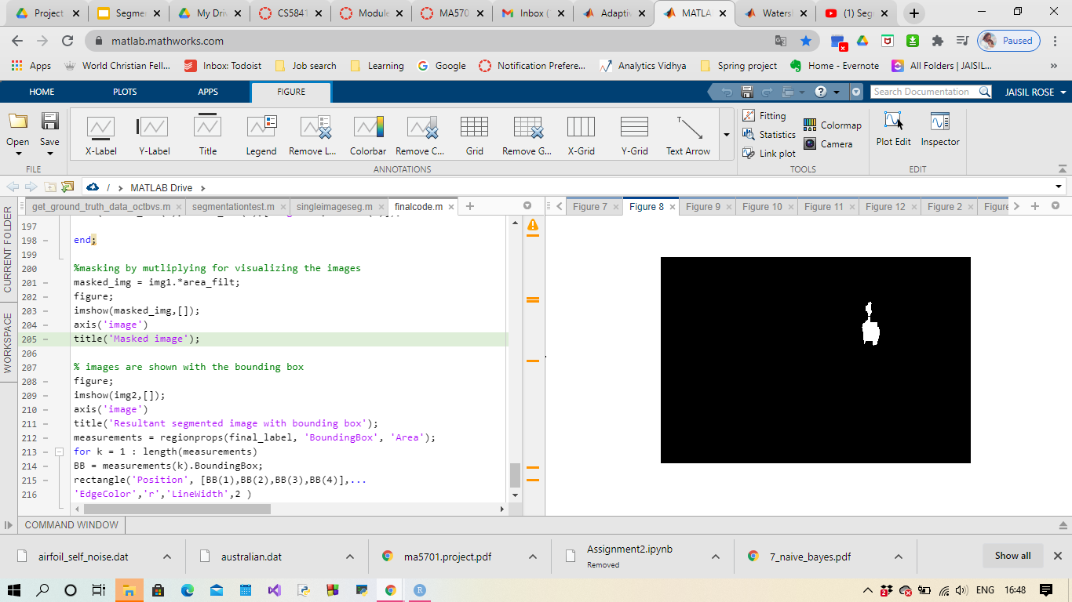
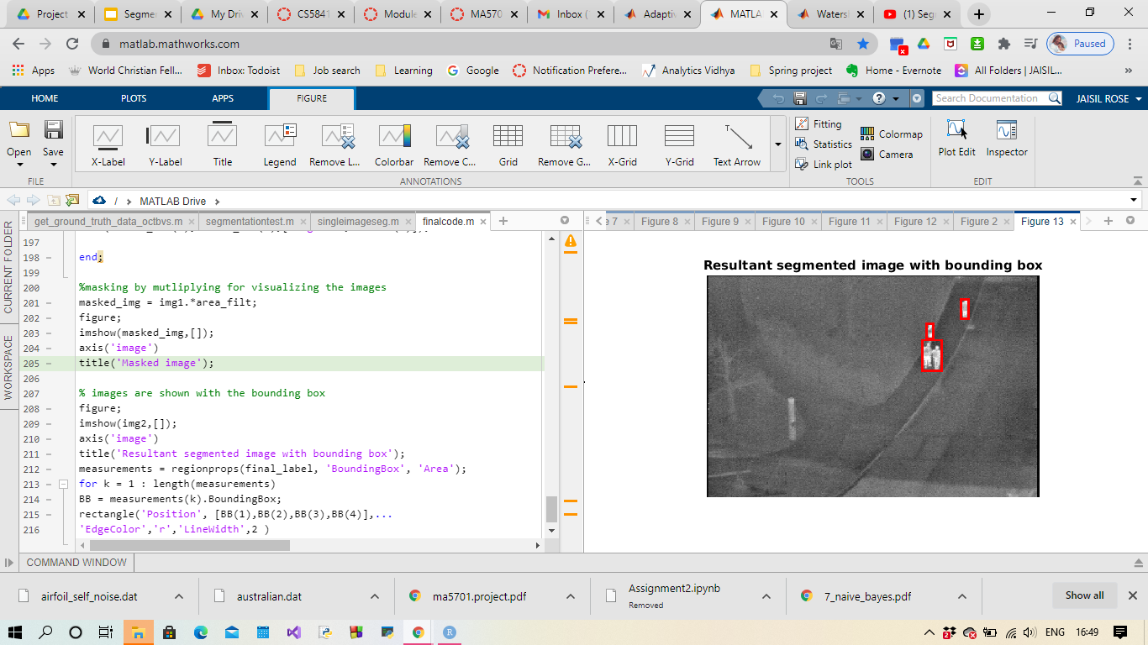
But..for three or more objects stuck together, the results are poor!

Slide 14
Morphological refining- How did I do it?
The sticky objects are counted as one objects, we don't want that!
After many trial of other object separating methods like erosion by for loop, watershed segmentation, the morphological based operations works better!
The other two methods results in over segmentation and object separation problem.
Initially the sticky object is separated from the other objects using area based filtering.

Slide 15
Morphological refining- How did I do it?...(Continuation)
The area is the number of the pixels within a labeled object. For this case, the area range is above 250.
We continue the process if there are any sticky objects otherwise the image from the height width ratio filtering is the final segmented image.
If any object in, then we start with masking as we need the original intensity value and again we threshold.
Then area opening is performed using rectangular of dimension 6x 3 as structuring element and further dilation is performed for minor shape adjustment.
Thus we get the sticky objects separated.

Slide 16
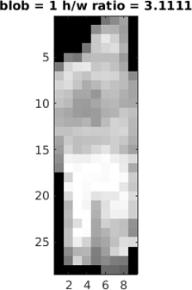
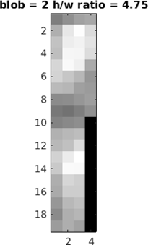
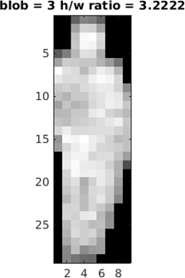
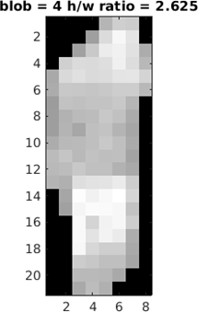
Segmented output
The separated objects are added to the height width ratio filtered image (if any sticky objects) .
Bounding boxes are calculated for each individual objects.

Slide 17
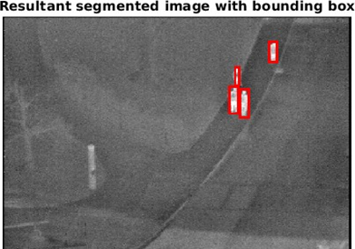
Segmented output

Slide 18
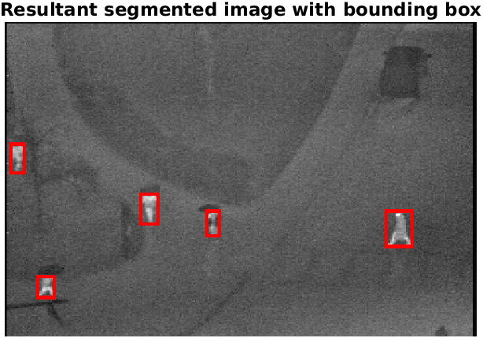
Result and conclusion
Applying the algorithm for the testing set
Test input image Segmented output image

Slide 19
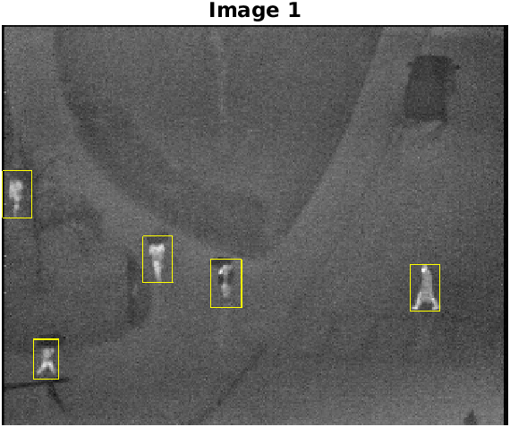
Result and conclusion (Continuation)
After analyzing with ground truth using get_ground_truth_data_octbvs.m by comparing the center of each bounding box in the two resultant images.

Slide 20
Result and conclusion (Continuation)
Total test Images: 31
Total objects: 90
The confusion matrix obtained is:
 | OBJECTS | CLUTTERS
OBJECTS | 81 | 9
CLUTTERS | 4 | -

Slide 21
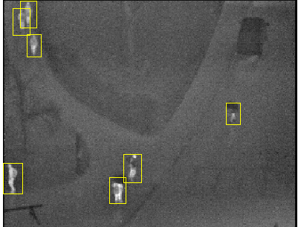
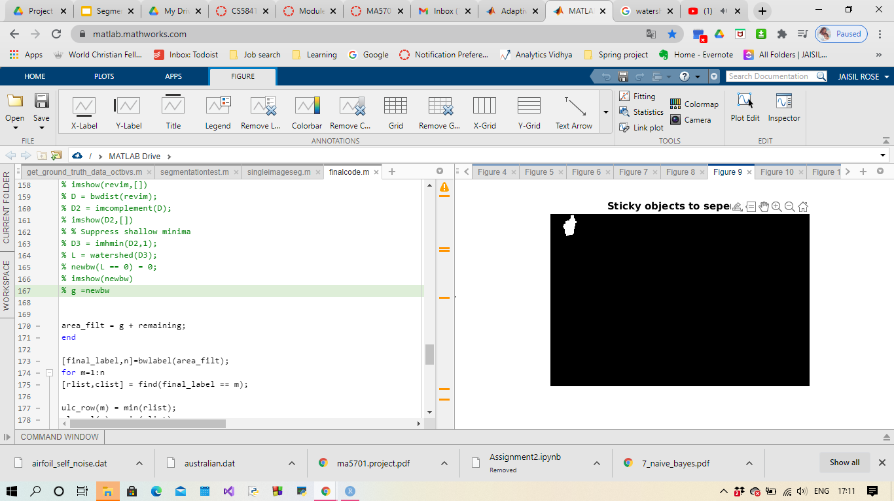
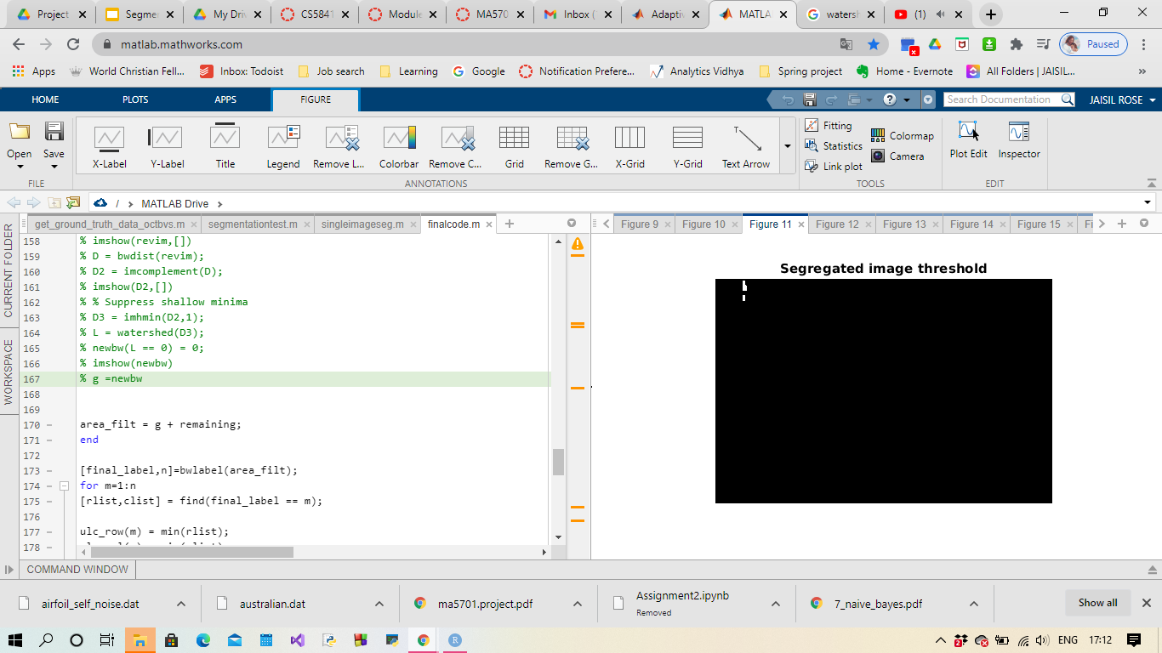
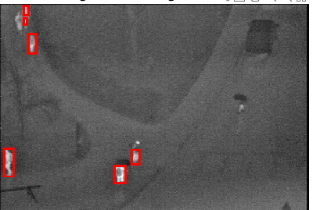
Result and conclusion (Continuation): Cause of missed objects and false alarm (Improper segregation and black object absorption):

Slide 22
Result and conclusion (Continuation)
The segmentation algorithm uses series for morphological operations and this can be reduced by performing cascaded morphological operations in one step.
Can come up with good sticky objects separating algorithm such as modified watershed segmentation or segmentation algorithm based on edges as this seems to be subjective!
For the black absorbed region inverse thresholding can be applied to extract just the darker objects like the black umbrella and black coat!
Adaptive thresholding can be done using otsu method!

Slide 23
References
1.http://vcipl-okstate.org/pbvs/bench/
2. https://en.wikipedia.org/wiki/Image_\egmentation
3.https://scikit-image.org/docs/dev/auto_examples/applications/plot_morphology.html#:~:text=Morphological%20closing%20on%20an%20image,and%20connect%20small%20bright%20cracks.&text=Since%20closing%20an%20image%20starts,the%20structuring%20element%20are%20removed.
4.https://en.wikipedia.org/wiki/Opening_(morphology)#:~:text=Opening%20removes%20small%20objects%20from,specific%20shapes%20in%20an%20image.
5.https://www.mathworks.com/help/images/structuring-elements.html#:~:text=A%20structuring%20element%20is%20a,process%20in%20the%20input%20image.

Slide 24
Questions?
Feedbacks?

